Slide 1

Next-generation HPE ProLiant:
Compute engineered for your hybrid world
Speaker name and title
Month DD, 20YY

Slide 2
Note to presenters
These PPT slides are for HPE and Partner seller use only, as they have:
  The disclosure label Confidential | Authorized HPE Partner Use Only
  Speaker notes and intent statements on every slide
Customers should only see PPT files of presentations that do not have disclosure labels or speaker notes.
  We have created the PPT version of this presentation and published it to Seismic as “without speaker notes” ready for you to share and send.
  Or, you may customize this presentation, then remove all disclosure labels, save it as a PDF, and share it with customers.
  It is important to share a PDF version of the presentation to ensure all fonts properly display.
Note that each slide has an intent statement and speaker notes to help you deliver the best presentation.
Add your name to the title slide.
Please delete this slide before presenting.

Slide 3
Confidential Disclosure Agreement
The information contained in this presentation is proprietary to Hewlett Packard Enterprise and is offered in confidence, subject to the terms and conditions of a binding Confidential Disclosure Agreement (CDA)
HPE requires customers and partners to have signed a CDA in order to view this training
The information contained in this training is HPE confidential
This presentation is NOT to be used as a ‘leave behind’ for customers and information may only be shared verbally with HPE external customers under NDA
This presentation may be shared with Partners under NDA in hard-copy or electronic format for internal training purposes only
Do not remove any classification labels, warnings or disclaimers on any slide or modify this presentation to change the classification level
Do not remove this slide from the presentation
HPE does not warrant or represent that it will introduce any product to which the information relates
The information contained herein is subject to change without notice
HPE makes no warranties regarding the accuracy of this information
The only warranties for HPE products and services are set forth in the express warranty statements accompanying such products and services
Nothing herein should be construed as constituting an additional warranty
HPE shall not be liable for technical or editorial errors or omissions contained herein
Strict adherence to the HPE Standards of Business Conduct regarding this classification level is critical

Slide 4


Agenda
The transformation imperative
Next-generation compute
As-a-service approach

Slide 5

Digital
transformation
is essential.
Data-first modernization makes it possible.
Notes:
Key takeaway: Today’s digital transformation journey requires the ability address the key data challenges enterprises are facing today – data-first modernization.
Across industries, and at almost any scale, digital transformation has become an imperative and is critical to competitiveness and growth. Thriving in today’s digital-first world requires a shift in mindset—understanding that data is the key driver of value creation, and a key organizing principle for business success. Adopting a data-centric mindset is the first step toward a new approach: creating and delivering value by understanding, aligning, and actioning the available data – from edge to cloud and everywhere in between.
Digital transformation is essential.
Highly successful agile transformations have delivered 30% gains in efficiency, operational performance, customer satisfaction, and employee engagement—and make the organization 5X to 10X faster. From “The impact of agility: How to shape your organization to compete” (McKinsey, May 2021)

Slide 6
Data-first-led organizations
have
49%
more product/service innovation in the last year than their non-data-centric competitors¹
are
20X
more likely to beat their competitors
to market by multiple quarters²
are
11X
more likely to beat their revenue goals by 10% or more²
1. “The impact of agility: How to shape your organization to compete” (McKinsey, May 2021)
2. “Why Being a Data-first Leader Matters.” Enterprise Strategy Group, a division of TechTarget, 2022)
Notes:
Key takeaway: Successful organizations put data-first
Despite tremendous investment in digital transformation, many businesses are still falling behind, unable to keep pace with the outperformers.
These outperformers—data-first leaders—are using data to see around the corner and to drive actionable insight.
This means that data is your most valuable asset—if you can put it to use, it’ll fuel your success.
But don’t take our word for it: data-centric enterprises are way ahead—and extending their lead.
“The impact of agility: How to shape your organization to compete” (McKinsey, May 2021)
“Why Being a Data-first Leader Matters.” Enterprise Strategy Group, a division of TechTarget, 2022

Slide 7

Past
Present
As the world gets more hybrid,
compute won’t look
the same
Centralized
architecture
Distributed
across the enterprise
Complex
management
Simple
cloudlike management
Disparate
security approach
Integrated
security at the core
Inefficient
general-purpose performance
Optimized
task-specific performance
Rigid and unpredictable
business model
Flexible
as-a-service model
Notes:
Key takeaway: As the world gets more hybrid, compute won’t look the same—because it must contend with new challenges:
Massive volumes of data, massively distributed.
Greater security risks
More demanding workloads, with more specific requirements
The need for greater efficiency, more agility, and greater manageability.
The complexity of hybrid structures, with resources and assets in the cloud, in the datacenter, at the edge, and everywhere in between
PAUSE
Compute in a hybrid world doesn’t look—or act—like compute of the past.
Legacy centralized architectures. Data is everywhere across a modern organization. Organizations need compute that is distributed across the enterprise—that lives where the data is stored and where it is created—without compromising manageability or security.
Complex management. Legacy IT management regimes are highly manual, with disparate systems and functions controlled independently. To accelerate digital transformation, a modern compute infrastructure should be managed through a simple to manage and operate control layer that delivers a cloudlike experience on-premises—one that offers greater simplicity, agility, and speed across your entire compute landscape, globally.
Legacy security approaches. Security risk is constantly evolving, and as digital transformation reimagines and redesigns an IT infrastructure, vulnerabilities and attack surfaces can proliferate. Data-centric modernization requires a compute backbone that’s secure at the core —helping to strengthen and harden the entire environment from the ground up.
Inefficient general-purpose performance (compute performance needs). Customers need compute that’s scalable and performance optimized for specialty workloads, and with the power to handle huge volumes of data and power the most demanding apps and workloads, such as VDI, database, and data analytics, to support Machine Learning and AI initiatives.
Rigid and unpredictable business models. Compute must be efficient and cost-effective. Organizations need to re-evaluate if capex or opex is right for their business. Next-gen HPE compute is the fast, flexible compute infrastructure your business requires, whether you choose a purchase or as-a-Service model.

Slide 8

In today’s hybrid world, choice of
compute is a game-changer for
data-first
modernization.
Focus more on value add and less on the mundane
Deploy with confidence and have peace of mind against security threats
Power your apps and accelerate innovation everywhere data lives
Notes:
Key takeaway: with the right compute in place, you’re primed for data-first modernization.
In today’s hybrid world, choice of compute is a game-changer for data-first modernization
Data-first modernization has to happen everywhere data lives – edge, datacenters, colocations and clouds – and through a unified operating model. HPE is here to help you on this journey so you can:
Focus more on value add and less on the mundane
Deploy with confidence and have peace of mind against security threats
Power your apps and accelerate innovation everywhere data lives

Slide 9


Choice of compute is critical
to digital transformation success
Compute
powers your
applications
Compute accelerates
your analytics
Compute
separates signal from noise
Compute
turns data
into value
Notes:
Key takeaway: compute is not created equal—and the choice you make is critical to your digital transformation success.
What turns data into value? What makes it power?
COMPUTE.
Compute powers your applications. The applications on which your business runs require compute—it’s the nexus between the data and the application user, and it runs the application’s software.
Compute accelerates your analytics. The more data, the more potential—and the greater the need for advanced analytics: AI and machine learning can speed the transformation of data to insight—and they are powered by advanced, accelerated compute.
Compute separates signal from noise. Compute narrows the funnel from the broadest data to insight to modeling to testing—distillation to the finest point of utility: performance and competitive advantage.
Compute turns data into value. The insights that fuel innovation, and that power competitive advantage, are locked within your data. Compute brings them to light.
Your choice of compute matters.

Slide 10



Intuitive
Accelerate data-first modernization
Trusted
HPE ProLiant
Compute engineered for your hybrid world
Optimized
Notes:
Key takeaway: HPE ProLiant is compute engineered for your hybrid world.
HPE ProLiant is secure, efficient, optimized, and it’s engineered for hybrid environments.
It supports distributed approaches, moving compute out of centralized datacenters and deploying it as a backbone throughout your operations—across multiple clouds, multiple datacenters and at the edge.
And it’s simple to operate, with location-agnostic, cloud-based compute management ensuring visibility and consistency despite increasingly diverse compute locations and workloads: unifying operations across the lifecycle and throughout the environment, while empowering security and automation.
HPE compute delivers an intuitive cloud operating experience; trusted security by design and optimized performance for your workloads.

Slide 11


Intuitive cloud
operating experience
Simple
Unified
Automated
Securely transform your IT focus from the manual and mundane to strategic and value-adding
Notes:
Key takeaway: Simplify the way you control compute from edge to cloud with an intuitive cloud operating experience.
Transform business operations and pivot your team from reactive to proactive with global visibility and insight through a unified console.
The next-gen HPE ProLiant is engineered with a cloud experience, no matter if you choose a purchase or consumption model.
Business outcomes:
Modernize lifecycle management with cloud simplicity
Unify compute management with a centralized console for self-service operations
Automate tasks for efficiency, reducing manual effort in deployment, and achieve seamless, simplified support and lifecycle management.
Securely bring cloud agility to distributed compute infrastructure

Slide 12

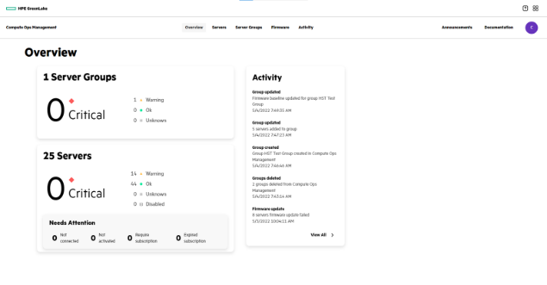


5X
Faster server
firmware updates¹
Simple
Modernize lifecycle management with cloud simplicity
Easily onboard 1000s of distributed devices.
Monitor and manage global server environments from a single console with enterprise security and consistent, compliant processes.
Simplify server lifecycle management with HPE GreenLake for Compute Ops Management.
Notes:
Key takeaway: Modernize lifecycle management with cloud simplicity
Enables a modernized compute management experience delivered through HPE GreenLake that securely streamlines operations from edge-to-cloud.
Firmware updates are the number one pain point with server management – with HPE Compute Ops Management you can achieve 5X faster server firmware updates . COM replaces manual, piecemeal firmware updates with automated, policy-based updates—sealing a key vulnerability
Kimley Horn customer reference
Monitor and manage all servers globally from a single console COM replaces legacy management tools with a centralized platform that lets you manage all your compute, wherever it lives, from one console.
Easily onboard 1000s of distributed devices
Bring enterprise security and consistent, compliant processes to your distributed compute infrastructure

Slide 13
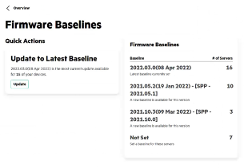
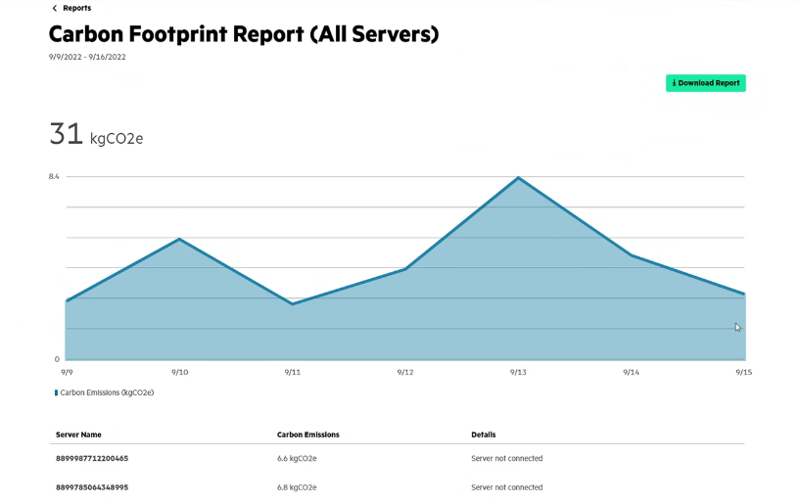
Unified
View health and firmware
status of all servers
Unify compute management with a centralized console for self-service operations.
Global visibility and insight
of all compute devices
Gain new sustainability insights with Carbon Footprint reports
Notes:
Key takeaway: Unify compute management with a centralized console for self-service operations
Pivot IT resources from reactive to proactive with global visibility and insight of all compute devices
View health and firmware status of all servers across the distributed environment from main dashboard At-a-glance visibility into the health of your entire distributed compute ecosystem.
Gain new insights – Carbon Footprint reports allow customers to see emission metrics for individual servers as well as full environment and lay the groundwork for improving your environmental sustainability through a clear view of the energy and environmental performance of your compute

Slide 14
Faster and easier server updates
REST APIs update servers with bulk scripted actions and set policy-based firmware compliance baselines
Automated
Reduce manual efforts and gain support efficiencies
Automated monitoring
and supportability
with instant notifications of critical issues and automatic case creation and support requests for hardware failures
Notes:
Key takeaway: Reduce manual efforts and gain support efficiencies
Automated tasks help speed server updates, mitigate risk and reduce time spent preparing and running system updates.
REST APIs make server updates faster and easier by rendering all server performance and condition information consistent and readable, even in a heterogenous infrastructure environment. This “common language” allows centralized, unified management, such as:
Update servers with bulk scripted actions
Set policies for firmware baselines and compliance
Automated monitoring and supportability. Instantly receive email notifications of critical hardware issues
Critical issues trigger auto-case creation for hardware failures and sends support request to HPE Pointnext to order and replace

Slide 15
An intuitive management experience is yours
without security compromises.
Powered by HPE GreenLake Compute Ops Management—
keeping infrastructure up-to-date with latest firmware, security patches and features.
Secure authentication from
cloud-based management platform to the individual server level
AES-256 encryption of all customer data in Compute Ops Management
Multi-tenant isolation ensures logical separation from other Compute Ops Management users
Notes:
Securely bring cloud agility to distributed compute infrastructure
Key takeaway: The COM-powered experience of HPE ProLiant management introduces no security compromise—in fact, it powers security improvements.
The intuitive experience of HPE ProLiant management comes without security compromise—it’s powered by HPE GreenLake Compute Ops management to help ensure data and operational security, and powering automatic and policy-based updates to firmware, as well as security patches and new features.
Securely bring cloud agility to distributed compute infrastructure
Stop managing your management tools - Cloud-based management keeps infrastructure up-to-date with the latest features, security patches and firmware versions
Secure, authenticated connection between HPE GreenLake Platform, HPE GreenLake Compute Ops Management and devices ensures you maintain control of access and your environment
HPE GreenLake Compute Ops Management delivers against three key requirements:
Authentication - HPE CA certificates are used by both Compute Ops Management in the cloud, and HPE iLO management processor embedded in the server to verify each other’s authenticity
Data encryption in the cloud - All customer data in Compute Ops Management is encrypted using AES-256
Multi-tenant isolation for safety - The data of each Compute Ops Management customer is logically separated from that of other tenant companies, providing privacy and data access protection

Slide 16


Trusted security
by design
Fundamental
Uncompromising
Protected
Deploy with confidence and have
peace of mind against security threats
Notes:
Transition: So, we’ve been talking about the security features built into HPE GreenLake Compute Ops Management. Let’s take a step back and talk about the security of HPE ProLiant servers: trusted security by design.
Key takeaway: Security is a foundational element of HPE ProLiant—and choosing HPE ProLiant adds a security backbone to your environment.
From silicon to software, from factory to cloud, and from generation to generation, HPE ProLiant is engineered with a fundamental security approach to defend against increasingly complex threats through an uncompromising focus to deliver constant security advancements that’s built into our DNA.
Protect your infrastructure, workloads, and data from threats to hardware, and risks from third-party software, with a trusted edge-to-cloud security posture built on an HPE compute core hardened through a proven, zero-trust approach to security.
Industry-leading security innovation
Extending protection to partner ecosystem
Expanding trusted supply chain security

Slide 17

HPE zero-trust architecture
    Platform certificates and iDevID and TPM integrated into the server
Fundamental
Industry-leading security innovation
from edge to cloud
HPE GreenLake
Compute Ops Management
    Policy-driven firmware updates, security patches
    AES-256 encryption of all your data in the platform
HPE Silicon Root of Trust secures
millions
4 million
of lines of firmware code
HPE servers around the world
Notes:
Key takeaway: HPE continues to lead and deliver infrastructure security innovations, from edge to cloud, with a fundamental zero-trust lifecycle approach.
At the silicon level, HPE security technological innovations continuously provide zero-trust architecture against more advanced and persistent security threats. In Gen 11, new security features include platform certificates iDevID by default and TPM is integrated into the server.
HPE Silicon Root of Trust:
protects millions of lines of firmware code from malware and ransomware with a digital fingerprint that is unique to the server
secures over 4 million HPE servers around the world
Citations of Proof Points:
CLAIM: HPE Silicon Root of Trust with an iLO6-enabled Gen11 ProLiant server is the foundation of trust that ultimately protects millions of lines of firmware within the server from malware[1]
[1] SOURCE: Information provided by Luis Luciani, Dir Engineering
CLAIM: secures over 4 million HPE servers around the world [2]
[2] SOURCE: ‘Hewlett Packard Enterprise reports fiscal 2022 third quarter results’, AUGUST 30, 2022
https://www.hpe.com/us/en/newsroom/press-release/2022/08/hewlett-packard-enterprise-reports-fiscal-2022-third-quarter-results.html#:~:text=Q3%202022%20Financial%20Highlights%3A&text=Diluted%20net%20earnings%20per%20share,period%20and%20up%209%25%20sequentially
HPE has built security innovations through the years. HPE continues to lead and deliver infrastructure security innovations in the industry. HPE Silicon Root of Trust is our fundamental approach to security to provide zero-trust architecture at the silicon level. More than million lines of firmware code run before the operating system starts, making it essential to confirm that all server essential firmware is free from malware or compromised code. With this industry-leading technological innovation, HPE is securing over 4 million servers around the world.
With the new HPE ProLiant Gen 11, the inclusion of platform certificates and Secure Device Identity (iDevID) cryptographic , which is a factory installed device identify, prevents alterations to unique server identity. This will result in having a newly installed server as a trusted device in the IT environment.
HPE Servers are provisioned with an industry-trusted Trusted Computing Group (TCG)-compliant platform certificate. HPE Servers are provisioned with an industry-trusted Trusted Computing Group (TCG)-compliant platform certificate. Platform certificates are used to detect supply chain tampering. For instance, a platform certificate would be created and digitally signed at the HPE manufacturing site. The platform certificate is then stored on the server. The customer can use a HPE supplied tool to verify the server using the platform certificate. (HPE has now added Platform Certificates, a Trusted Computing Group (TCG) Compliant Platform Certificate implementation that provides the ability for customers to attest to the authenticity of the server and components from the original factory condition.)
Initial Device Identity allow for the automatic provisioning. iDevID provisioned by the HPE factory enables the organization to authenticate and authorize HPE systems via the local router before connecting to the network. Then the 802.1x EAP-TLS protocol onboards the servers automatically, enabling HPE systems to securely establish its identity in the customers network with “zero touch” (unattended autonomous operation).
With iDevID and Platform certificates, you can create your Zero Trust Edge from the ground up, knowing that the hardware your system depends on is in a secure, good state. For HPE servers, these technologies are built-in.
Our customers are also gaining an additional layer of authentication by monitoring a secure boot and system state using the Trusted Platform Module (TPM ). A TPM which is a separate processor is now fully integrated with the new HPE ProLiant servers. Trusted Platform Modules (TPM) are computer chips that securely store artifacts used to authenticate the platform. These artifacts can include passwords, certificates, or encryption keys. You can also use a TPM to store platform measurements to make sure that the platform remains trustworthy.
This is our core foundation. The value of this compute security foundation of HPE ProLiant servers extends to services within HPE GreenLake. The utilization of Compute Ops Management with HPE GreenLake provides a policy-driven means of keeping servers in compliance and secure, authenticated connection from the device to the cloud. HPE COMs provides AES-256 encryption of all your data in the platform
This is our fundamental approach to zero-trust security. HPE has the industry-leading security innovations from edge to cloud. From the silicon to the cloud.

Slide 18
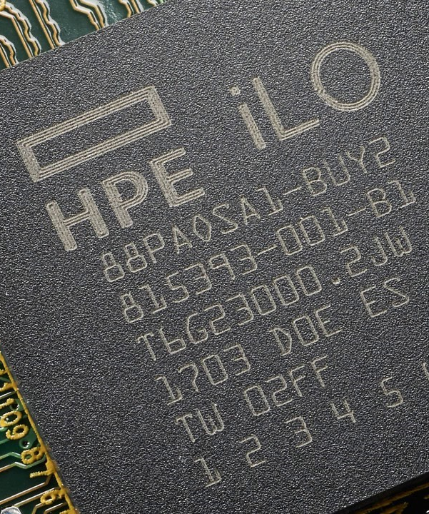
Uncompromising
Extending protection to partner ecosystem
Component integrity
Expanding iLO6 verification to select storage and network controllers (SPDM)
Notes:
Key takeaway: Extending protection to partner ecosystem with continuous innovations for best-in-class security through strong ecosystem partnership and collaboration.
Beyond the silicon, the authentication of platform components secures against potential entry points of security threats that can compromise the entire server infrastructure.
Through iLO6 verification in Gen 11, the new authentication of PCIe firmware with Security Protocol and Data Model (SPDM) ensures the component’s integrity.
Select PCIe storage and network controllers with SPDM certification will be available with Gen11 servers: Broadcom storage and network controllers
The value of compute security element of HPE ProLiant servers extends to services within HPE GreenLake.
Other components in the server could be potential entry points of security threats that can compromise the entire server infrastructure, how do we verify and authenticate other server components?
Through our efforts, HPE is achieving continuous innovations for best-in-class security through strong ecosystem partnerships and collaboration. One example is our collaboration with DTMF. DMTF (formerly known as the Distributed Management Task Force) creates open manageability standards spanning diverse emerging and traditional IT infrastructures including cloud, virtualization, network, servers and storage. HPE’s collaboration with DMTF focuses on SPDM - Security Protocol and Data Model for a more integrated and cost-effective approach to management through interoperable solutions.
Other components like storage controllers and network interface cards are verified and authenticated using the new version of the HPE Integrated Lights-Out (iLO), with iLO6. HPE ILO is a remote server management software that enables our customers to securely configure, monitor, and update HPE servers seamlessly. The latest version features new authentication using the Security Protocol and Data Model (SPDM) certification, a key security capability in servers to ensure the component's integrity.
Select PCIe storage and network controllers with SPDM certification will be available with Gen11 servers: Broadcom storage and network controllers
HPE will continue to work with other partners in the ecosystem to secure the IT deployment to avoid potential entry points against security threats that can compromise the entire server infrastructure

Slide 19
Protected
Optimized protection and confidence for HPE ProLiant servers from
Expanding Trusted Supply Chain security
trusted suppliers
HPE Server Security Optimized Service
extends supply chain leadership globally
Trusted Supply Chain
expanded to include more workloads
available for Intel servers
to
manufacturing facility
and
while in transit to you

Slide 20
Why hardware-based security is critical
Security is only as strong as the layer below the point of attack
Applications
Ransomware, malicious insider, malware, phishing, SQL injection, theft, trojan horse, user error, water-holing, zero day attack
HPE GreenLake
Security protection
Platform
Operating System
DOS, DDOS, user error, worms
TPM, SED Drives,
Storage Controllers
Ransomware, man in the middle, user error, worms
Firmware rollback protection
UEFI/BIOS/Firmware
Malware, data theft, theft of hard drives
Continual attestation during runtime
Processor authenticates itself using cryptographic attestation
Root kit, boot kit, booting into alternate OS, phlashing
Processor Attestation
Boot Kit, root kit, tampering, data theft
Boot with an immutable
(unchangeable) source in silicon
Silicon Root of Trust
Malware (firmware), unvalidated firmware updates, theft of data
Begin with secure supply chain
Secure Supply Chain
Counterfeit materials, malware, tampering, theft, root kit, boot kit
Establish a chain of trust up the boot stack,
all the way to the application
HPE Protection
Notes:
Key takeaway: Hardware security is the foundation on which every other security effort stands—cloud security can’t exist without hardware security.
Here’s a view of the complete compute security stack
With end to end security features, from the devices to the cloud
Security triggers for hardware security through supply chain (Green Box for Secure Supply Chain gives trusted supplier relationship proof point)
HPE continues to lead and deliver infrastructure security innovations, from edge to cloud, with a fundamental zero-trust lifecycle approach.
At the silicon level, HPE security technology innovations continuously provide zero-trust architecture against more advanced and persistent threats.

Slide 21


Optimized performance
for your workloads
Efficient
Accelerated
Open
Accelerate innovation
everywhere your data lives
Notes:
Transition: Now let's talk about how HPE ProLiant next-gen compute will optimize performance for your workloads.
Key Takeaway: HPE ProLiant Gen11 was designed to deliver the advanced performance a modern, data-centric enterprise requires.
While designing the new Gen11 servers we had three key focus areas:
First, the next generation of HPE ProLiant will deliver new levels of efficiency to power applications with the right economics for optimal business value both in the data center and across the edge.
Second, in particular, this new generation brings optimal performance for demanding applications that require the most advanced graphics and data acceleration.
Finally, we want to help you address the new wave of data center needs with an open approach. This includes delivering efficiencies for cloud-native workloads at scale and enhancing infrastructure as code - building on decades of commitment from HPE to industry standards.
Optimized performance for your workloads
Get the performance you demand to accelerate any workload —from the data center to the edge—with HPE ProLiant compute that’s engineered for your hybrid environment. Deploy seamlessly while achieving optimal performance for demanding applications requiring the most advanced graphics and data acceleration. Address new wave of data center needs with an open approach that delivers efficiencies for cloud-native workloads at scale. Achieve advantageous efficiencies spanning operational, and performance economics to power your apps and accelerate innovation everywhere your data lives.
Expect more from your infrastructure
More graphics capabilities than ever before
Advancing your most demanding workloads

Slide 22

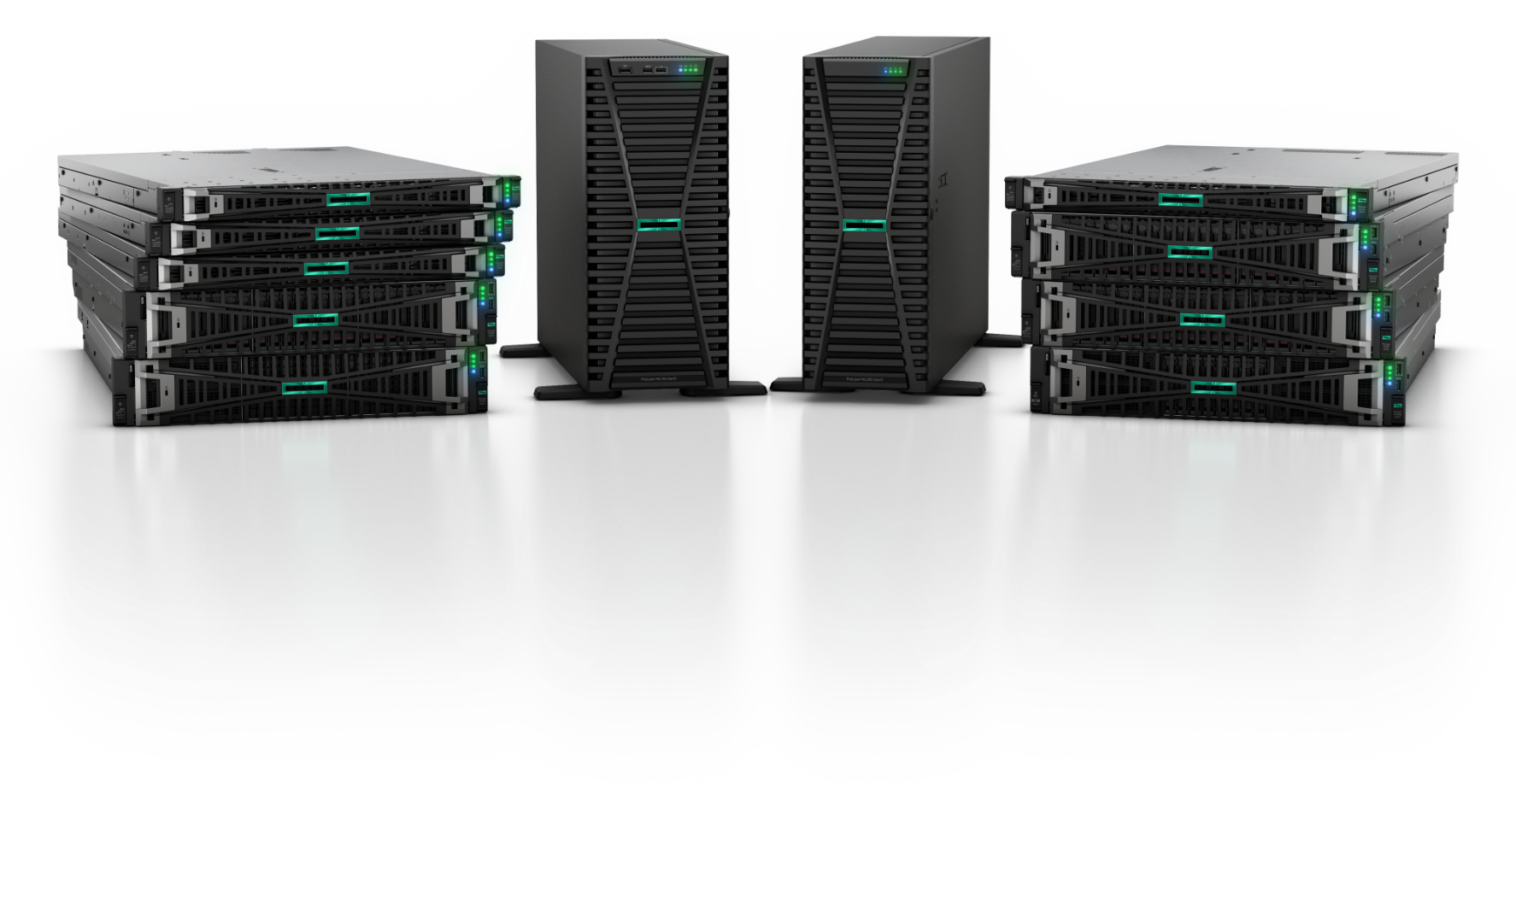
Efficient
Expect more from your infrastructure
Up to
Up to 43% more energy efficient compared to previous generation²
50% more cores per CPU for improved workload consolidation³
2X more I/O bandwidth with more room for data and graphics acceleration⁴
Modernize your business with scalability, efficiency
and greater performance
99%
higher performance compared to previous generation¹

Slide 23
Accelerated
More graphics capabilities than ever before
Up to
Designed from the ground up to support advanced accelerators
Empower your business to innovate more for AI, ML, rendering, and data intensive applications
Boost AI inference performance by more than 5X from previous generation systems
33%
more high-performance GPU density per server to power next gen workloads¹
Notes:
Key takeaway: Advanced workloads increasingly rely on GPU accelerators, and HPE ProLiant Gen11 delivers with greater GPU density than ever before.
As I mentioned, we are going to deliver more graphic capabilities than ever before, so we are particularly excited about the GPU acceleration in the new Gen11 servers.
With up to 33% more GPU density, you get the flexibility to optimize scale with more high-end accelerators than ever before. You can power a wide range of graphics and compute use cases, both within the data center and at the edge.
This is a big benefit for your AI, Machine Learning, rendering, and other data intensive apps. These advanced GPU accelerators will unlock new opportunities for your teams to innovate everywhere your business is.
Source:
33% more GPU density - comparison of DL385 Gen11 with 4 double wide GPUs to DL385 Gen10 Plus v2 with 3 double wide GPUs
5X - NVIDIA: : Comparison for image generative AI performance of NVIDIA L40 (TensorRT 8.6.0) versus T4 (TensorRT 8.5.2), Stable diffusion v2.1 (512x512)

Slide 24
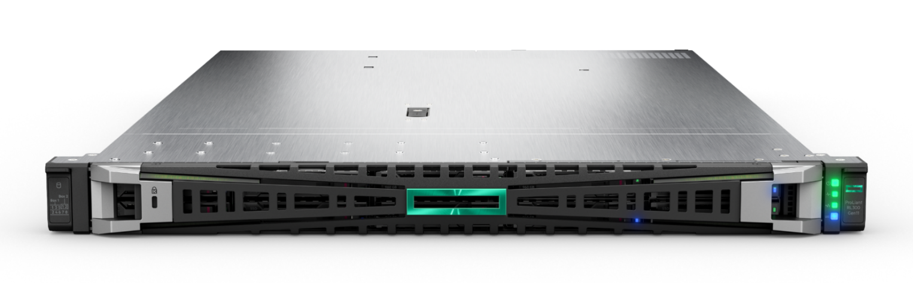
Open
An open approach to your most demanding workloads
30+
Enabling more infrastructure as code with expanded support for industry standard protocols like Redfish, PLDM and SPDM
Deliver scale-out performance with greater energy efficiency for cloud native workloads using HPE ProLiant RL300 Gen11
Choice of management for cloud native workloads on RL300 Gen11 of HPE iLO or OpenBMC
Increased adoption of Open Compute Project (OCP) standards driving better standardization across the data center with increased support and expanded capacity for OCP standard devices, including storage controllers
years of leadership
and commitment to industry standards
Notes:
Key takeaway: HPE ProLiant delivers exceptional flexibility and scalability through an open approach.
From its inception, HPE ProLiant has been focused on leading and adopting industry standards, and Gen11 continues that journey. We can help you grow your business at a scale with an open approach to industry standards and flexible management of cloud native workloads.
A great example is the exceptional scale-out performance with greater energy efficiency of the HPE ProLiant RL300 Gen11.
With 128 cores per socket featuring Ampere processors, it delivers predictable performance and density for the cloud native workloads run by cloud service providers, digital service providers, and digital-first enterprises.
And the RL300 brings a choice of management for these workloads with either industry leading HPE iLO or open-source management with OpenBMC.
Beyond the RL300, all next generation HPE ProLiant servers enable more infrastructure as code with expanded support for industry standard protocols like Redfish, PLDM and SPDM.
And increased adoption of OCP or Open Compute Project standards drive better standardization across the data center. We’ll be offering increased support and expanded capacity for OCP standard devices, including storage controllers.
[MESSAGING]
Grow your business at scale with an open approach to industry standards for innovation of advanced technology in the data center and at the edge, and flexible management of cloud native workloads.
Enabling more infrastructure as code with expanded support for industry standard protocols like Redfish, PLDM and SPDM.
Deliver scale-out performance with greater energy efficiency for cloud native workloads using HPE ProLiant RL300 Gen11.
With 128 cores per socket, it delivers predictable performance and density for cloud service providers, digital service providers, and digital-first enterprises.
Choice of management for cloud native workloads with industry leading HPE iLO or expand your open-source strategy with OpenBMC on optimized cloud-native silicon of HPE ProLiant RL300 Gen11.
Increased adoption of Open Compute Project (OCP) standards driving better standardization across the data center with increased support and expanded capacity for OCP standard devices, including storage controllers.

Slide 25
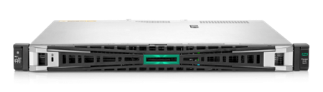
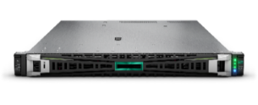
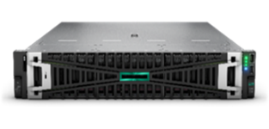
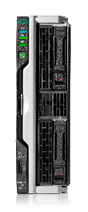
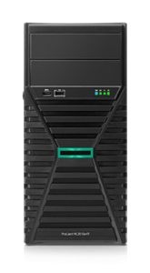
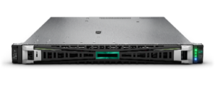
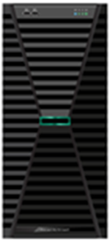
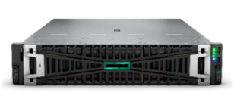
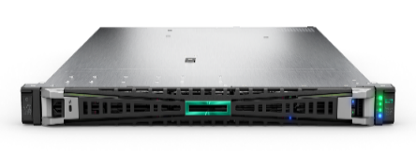
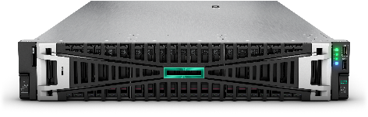
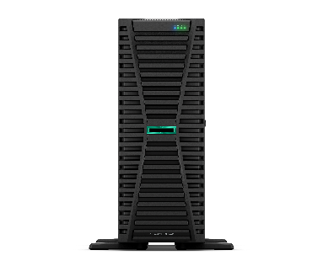
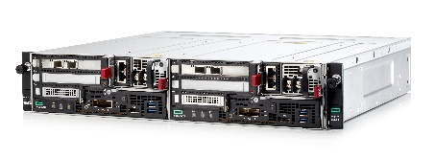
HPE ProLiant Gen11 Servers for everywhere your apps and data live
Edge optimized
Edge optimized
Density optimized
Accelerator optimized
Blade optimized
Tower, 1P
HPE ProLiant ML30 Gen11
Intel® Xeon® E-2400 Processor
1U, 1P
HPE ProLiant DL20 Gen11
Intel® Xeon® E-2400 Processor
1U, 2P
HPE ProLiant DL360 Gen11
4th and 5th Intel® Xeon® Scalable Processor
2U, 2P
HPE ProLiant DL380a Gen11
4th and 5th Intel Xeon Scalable processor
Blade, 2P
HPE Synergy 480 Gen11
4th and 5th Intel® Xeon® Scalable Processor
1U, 1P
HPE ProLiant DL320 Gen11
4th and 5th Gen Intel® Xeon® Scalable Processor
Tower, 1P
HPE ProLiant ML110 Gen11
4th and 5th Intel® Xeon® Scalable Processor
2U, 2P
HPE ProLiant DL380 Gen11
4th and 5th Intel® Xeon® Scalable Processor
Cloud optimized
Big Data optimized
1U, 1P
HPE ProLiant RL300 Gen11
Ampere® Altra® and Ampere® Altra® Max
2U, 4P
HPE ProLiant DL560 Gen11
4th and 5th Intel® Xeon® Scalable Processor
4U, 2P
HPE ProLiant ML350 Gen11
4th and 5th Intel® Xeon® Scalable Processor
2U, 2P
HPE Edgeline EL8000t
4th and 5th Intel® Xeon® Scalable Processor
Storage optimized

Slide 26
Leadership for performance and efficiency
3 for enterprise server-side Java
4 for artificial intelligence
42
5 for content apps
7 for big data
world records
6 for data management
6 for cloud and virtualization
11 for energy efficiency

Slide 27


Accelerate workload performance with HPE ProLiant Gen11
25%
Up to:
90%
more performance per kW versus Gen10 Plus³
better price/performance
Gen11 versus
Gen10/Gen10 Plus²
43%
reclaimed rack space
Gen11 versus Gen10 Plus¹
SPEC and the names SPECpower_ssj and SPECrate are registered trademarks of the Standard Performance Evaluation Corporation (SPEC). The stated results are published or under review as of 06-10-2023, see spec.org. All rights reserved.
SPECpower_ssj 2008 (same performance envelope): #1169 and 1185
SPECrate2017_int_base: #20893, 36218, 37007, 37004 and pricing on April / June 2023.
SPECpower_ssj 2008 (at 100% utilization): #1169 and 1185

Slide 28


Modernize workload efficiency with HPE ProLiant Gen11
Up to:
8:1
11:1
65%
6x
Gen9 to Gen11 server
consolidation¹
Gen8 to Gen11 server
consolidation³
power savings per year after Gen9 to Gen11 consolidation²
more performance per kW versus Gen8⁴
SPEC and the names SPECpower_ssj and SPECrate are registered trademarks of the Standard Performance Evaluation Corporation (SPEC). The stated results are published or under review as of 06-10-2023, see spec.org. All rights reserved.
SPECrate2017_int_base (same performance envelope): #36223, and 36691.
SPECrate2017_int_base (same performance envelope): #36223, and 36691, and power values estimated via HPE Power Advisor.
SPECpower_ssj 2008 (same performance envelope): SPECpower_ssj 2008: #1273 and 1274
SPECpower_ssj 2008 (at 100% utilization): #1273 and 1274

Slide 29
Optimized
performance for your workloads
Up to 43% more energy efficient compared to previous generation¹
50% more cores per CPU for improved workload consolidation²
2X more I/O bandwidth with more room for data and graphics acceleration³
Up to 33% more high-performance GPU density per server to power next gen workloads⁴
Workload characteristics
Processor
Memory
Storage
IO/Network
GPU

Slide 30

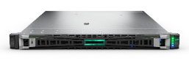
HPE ProLiant Gen11 Compute – optimized performance for your workloads
Accelerate innovation everywhere your data lives​
 | Hybrid Cloud | Cloud-Ready Containers | Cloud-native | Integrated Datacenter | Virtualization
Sockets | 2P | 1P/2P | 1P | 1P/2P | 1P
Rack | 1U, 2U | 1U | 1U | 11U (Frame) | 1U, 2U
 | DL360, DL380 | DL360* | RL300 | SY480 | DL360
Gen11 Ecosystem | vSAN ReadyNodes VMware VCF Azure Stack HCI | HPE Ezmeral Red Hat OpenShift *If internal storage is needed use DL380 | Microservice based Web-scale services, App delivery, OS databases, Caching ARM based ecosystem | HPE OneView, HPE GreenLake for Compute Ops Management, iLO, optimized management and lifecycle experience | VMware vSphere Microsoft Hyper-V
Processor
Memory
Storage
IO/ Network
GPU
Processor
Memory
Storage
IO/ Network
GPU
Processor
Memory
Storage
IO/ Network
GPU
Processor
Memory
Storage
IO/ Network
GPU
Processor
Memory
Storage
IO/ Network
GPU
Notes:
HPE offers both Reference Architectures and Reference Configurations to reduce the complexities of planning, designing, and implementing infrastructure across a variety of workloads and infrastructure platforms.
Speed deployment time with less risk using a repeatable, best-practices reference to determine particular, optimized configurations.
Reference Architecture include full tested and benchmarked workload architecture for optimized workload performance.
HPE offers a flexible model based on workload characteristics – with baseline configuration that can be scaled for customers’ unique needs. Customers can access software via HPE or they can leverage their own licenses agreements.
(Send demos after Discover)
Workloads Solutions Gen11 Positioning:
When it comes to our Gen11 portfolio, these are the “lead with” refreshed solutions to start in your customers conversations. It does not imply that customers cannot use other servers for these workloads. This provides guidance for a workload mapping and positioning discussion based on the advantages of how these products are built in order to deliver optimized workloads and solutions.
The Workload Characteristics demonstrate with server subsystems will benefit that workload the most. We can then determine which servers best meet the needs of the workload by mapping the subsystem score against available resources for each server. For instance, if a workload (like Transcoding/Visualization, a subset of Compute for AI) has a high affinity for processor, it will benefit by being run on a 2P server that supports high-performance CPUs (more cores or higher frequency—this is somewhat application dependent). This workload can also benefit from GPU acceleration so that means a 2U box will support more GPUs. That leads us to DL380 (DL380a actually) or DL385, as they both support up to 4 double-wide GPUs (up from 3 in Gen10 Plus).
Virtualization/VDI requires:
More cores and internal cache to run VM software
Memory bandwidth to support all virtual machines
More PCIe lanes to reduce latency
Data security without impacting server performance
Data Solutions (Data Management and Big Data) Requires:
Large number of storage devices for management software and data storage
High throughput and low latency: PCIe lanes and network bandwidth
Power/ Heat efficient for edge and power restricted data centers
Customer that will benefit the most from Gen11:
Performance-oriented customers such as Financial Services and Healthcare (likely users of ML)
Workloads benefiting from increased performance:
AI/ML
Data Analytics
Data Solutions
VDI
Gen11 will have potential, but Gen10 Plus may be preference due to cost / benefit for these workloads
Platforms/Workloads benefiting from increased performance:
Hybrid Cloud
Containers
Gen11 is not as likely, as Gen10 will likely be preference:
Price sensitive customers
SMB / transactional customers
Customers with limited power capacity per rack

Slide 31
Develop and deploy AI at any scale
Training
Build new AI models
Supervised or unsupervised learning
Inference
Run trained models
Real-time execution
Use Cases
Generative AI
Computer Vision training
LLM training
Scientific Discovery
Financial Market Modeling
Use Cases
Computer Vision
Natural Language Processing
Fraud Detection
Predictive Maintenance
Medical Imaging
Time to Results:
hours, days, weeks
Time to Results:
microseconds, milliseconds, seconds
HPE Cray
HPE ProLiant
Confidential | Authorized HPE Partner Use Only
Notes:
HPE Cray systems are uniquely positioned to TRAIN the largest of AI models with trillions of parameters. HPE ProLiant is ideal for AI INFERENCE (from the edge to data center and cloud). ProLiant servers provide outstanding cost-performance for inferencing use cases like:
Computer vision / intelligent video analytics
Natural language processing
Fraud detection
Predictive Maintenance

Slide 32
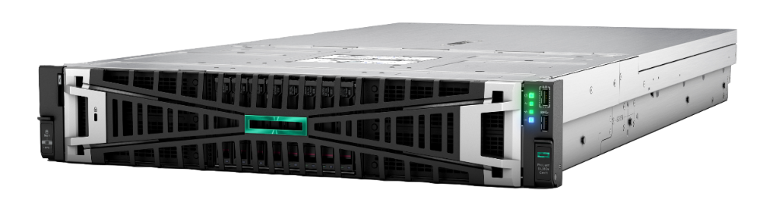
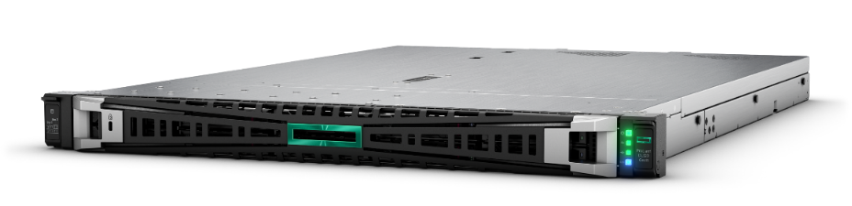
Accelerate your AI Inference Initiatives
NEW!
Computer Vision AI
at the Edge
Generative
Visual AI
Natural Language Processing AI
Purpose-built for AI at the edge
Loss prevention
Smart spaces
Optimized for visual apps
3D animation
Image/video generation
Powering large language models
Speech AI
Fraud detection
HPE ProLiant DL320 Gen11
HPE ProLiant DL380a Gen11
HPE ProLiant DL380a Gen11
Up to Four NVIDIA L4 GPUs
Up to Four NVIDIA L40 GPUs
Up to Four NVIDIA H100 GPUs
supporting NVLink
NVIDIA Metropolis ecosystem
NVIDIA AI Enterprise suite
NVIDIA AI Enterprise suite
Select configurations available for order today
Notes:
As the capabilities of AI evolve, companies are increasingly turning to AI inference solutions to deliver real-time results using pre-trained models. HPE has released three new AI inferencing solutions to accelerate time-to-value for a range of industries, including retail, hospitality, manufacturing, and media and entertainment.
Tuned to target workloads at the edge and in the data center such as Computer Vision AI at the Edge, Generative Visual AI and Natural Language Processing AI, these AI inference solutions are based on the new HPE ProLiant Gen11 servers which have been purpose-built to integrate advanced GPU acceleration which is critical for AI performance. HPE ProLiant DL380a and DL320 Gen11 servers boost AI inference performance by more than 5X over previous models.

Slide 33
HPE ProLiant Gen11 for AI
Workload-optimized and scalable compute solutions
Reduced complexity
and cost
HPE expertise
and partner ecosystem
Turn growing data into insight, action, and value - faster.
Use purpose-built HPE ProLiant servers designed to support AI from development to deployment.
Accelerate computer vision, NLP, and various AI workloads paired with NVDIA GPUs
Scale your AI systems as your
needs grow with the full suite of HPE ProLiant
Deploy AI from Edge to Core
Support AI initiatives with compute that increases flexibility, operational efficiency, and innovation potential.
Use AI to increase revenue, reduce support costs, and enhance market competitiveness.
Get AI as a service and accelerate time-to-value with HPE GreenLake.
Use a single vendor for your complete AI solution.
Fast-track your modernization, insights, and control.
Enjoy expertise based on hundreds
of AI and data platform engagements.
Experience an AI partner ecosystem
of experts.
Confidential | Authorized HPE Partner Use Only

Slide 34

Transformative approaches require re-thinking:
The need
to transform
is real.
Focus on business value
to achieve, rather than
infrastructure to maintain.
The way forward is less clear.
From a hardware mindset
to a performance mindset.
Notes:
Key takeaway:
To move forward, we have to recognize that transformation is a journey, one that requires you to re-think your approach and shift your focus.
Focus on business value to achieve, rather than infrastructure to maintain and from a hardware mindset
to a performance mindset.
It’s imperative that you move from a infrastructure-first to adopting a data-centric mentality and philosophy and drive a unified experiences across your hybrid-cloud environment
- Speed up decision velocity enterprise-wide via secure connectivity across edge to cloud

Slide 35

HPE GreenLake
for Compute
Edges
Colocation/Data centers
Clouds
Self-service
Pay-per-use¹
Scale up and down
Managed for you
1. Reserve may apply.
Notes:
Key takeaway: Narrowing the HPE GreenLake aperture down to the service(s) in question: HPE GreenLake for Compute
Lifecycle management for all of your servers, from edge to cloud, delivered as a secure SaaS application continuously managed and improved by HPE.
Free up capital, boost operational and financial flexibility, and free up talent to accelerate what’s next for you
Self-service: HPE GreenLake cloud platform is an intuitive self-service portal centralizing management, and giving broader visibility to your environment.
Pay-per-use: boost financial flexibility, free up capital, better control costs and align costs to business outcomes.¹ ⁽¹⁾reserve may apply
Scale up and down: scale resources up and down as you need to with ease, and capacity ahead of demand.
Managed for you by HPE and our partners: Management and governance services to operate the solutions for you, securely managed from HPE’s world-class IT Operation Centers (ITOCs) around the world, freeing up resources to be more productive.

Slide 36
HPE GreenLake
The open and secure edge-to-cloud platform
65%
operational savings
45%
reduced TCO
60%
efficiency gains
HPE GreenLake for Compute delivers the capability you need today
and the ability to quickly scale up as you grow
Notes:
Key takeaway: The benefits of HPE GreenLake are many: financial savings, efficiency improvements, and scalability to grow and evolve with your business.
HPE GreenLake
HPE GreenLake platform brings the cloud to you, to your apps and data where they are so you can accelerate time to value, boost operational excellence, free up capital and free up your talent for what’s next.
The fast, flexible infrastructure your business requires is delivered on a consumption pay-per-use basis, offering a range of workload-and cost-optimized configurations installed on premises and maintained for you by HPE experts. You pay only for the resources you consume, and built-in buffer capacity is ready to handle both steady growth and unexpected spikes in demand.
All quants are from The Total Economic Impact of HPE GreenLake https://www.hpe.com/psnow/doc/a00047694enw

Slide 37





Extending your transformation
The deep expertise and proven methodology of HPE Pointnext Services
help you innovate with confidence and get the best performance from your technology
HPE Pointnext Complete Care Secure Locations
HPE Expert on Demand
Longer duration support
Notes:
Key takeaway: Transformation isn’t a journey you have to take alone—HPE Pointnext services has the expertise and reach you need to solve for the future of your business.
If we think about the customer experience at each stage of their IT lifecycle, it is important to note that we have services to help customers along every phase of the lifecycle – from advising them on their digital transformation strategy, to helping them build the right solutions, to partnering with them to operate their solutions on an ongoing basis.
Since our services professionals have a trusted advisor status with customers, we get great insight into their needs and challenges, and that insight is used to build new services and capabilities to add even more value to their HPE experience.
HPE Pointnext Services, with its deep, global expertise, field-proven methodology, automated tooling, and expansive partner ecosystem, offers a flexible transformation approach designed to modernize what you have and incorporate emerging technologies— while helping you evolve your people and teams—so you can innovate with confidence.
Advisory and Professional Services can help you identify, prioritize, and implement the right transformation initiatives to create new edge experiences, get real-time insights from all your data, and modernize your IT to enable new opportunities
Operational Services offers expertise and tools that can help save your staff time, manage complexity, and identify new ways to drive efficiency and effectiveness.
HPE Pointnext Complete Care Secure Locations. Service for locations where physical access, connectivity and communications are restricted
New Capabilities: The Gen 11 experience includes support when, where and how customers want to receive it. As a key part of HPE Pointnext Tech Care and HPE Pointnext Complete Care, the HPE Support Center (HPE’s online services and support platform) has been enhanced to include:
Updated Service: Customers can now purchase HPE Expert on Demand to access services professionals with deep levels of expertise on Gen11 products and a wide array of other technologies. Experts available via live chat or phone, much deeper knowledge than trouble shooting agents.
Updated Service: Longer duration support provides your Gen 11 products with support for longer than the 3 or 5 year support agreements available in the past. You can now get support for up to 7 years.
New Service: With the new HPE Pointnext Complete Care Secure Locations, HPE account support managers will deliver the HPE Pointnext Complete Care experience for customer locations where not only the physical access and connectivity are restricted, but also any electronic or verbal communication related to these sites is subject to specific security measures.
HPE Support Center. Online services and support experience
The Gen 11 experience includes support when, where and how customers want to receive it. As a key part of HPE Pointnext Tech Care and HPE Pointnext Complete Care, the HPE Support Center (HPE’s online services and support platform) has been enhanced to include:
Greater collaboration: Customers can now create groups of related contracts and products to easily share cases, tasks, and alerts with their peers, HPE Authorized Partners, and HPE Account Services.
Connected: Machine-to-machine cases will be visible in the Case Management feature
Virtual Agent: Enhanced troubleshooting experience including assignment to live agent
Customer Collaboration (Shared groups): Shared groups help enable customers to create groups of related contracts and products to easily share cases, tasks, and alerts with their peers, HPE Authorized Partners, and HPE Account Services.
Insights Dashboards: Customers can now gain actionable insights about incidents, entitlements, assets and software version management.
HPE Expert on Demand. Access to professionals with deep levels of expertise on compute products and a wide array of other technologies.
Longer duration support. Gen 11 product with support for longer than the 3 or 5 year support agreements available in the past. You can now get support for up to 7 years.

Slide 38
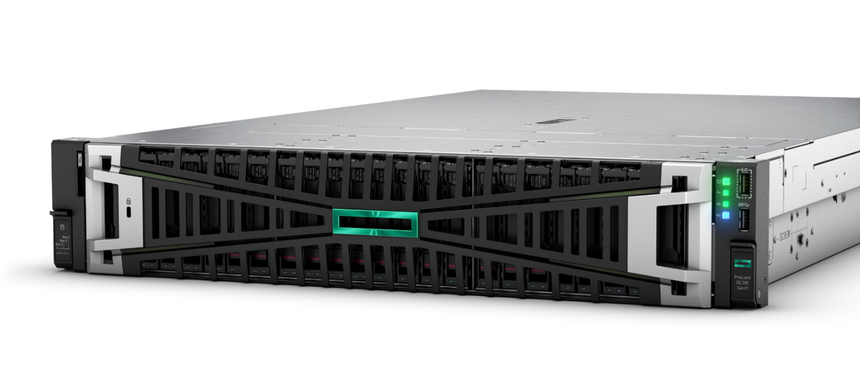
Accelerate data-first modernization.
HPE ProLiant
is compute engineered for your hybrid world
Intuitive
cloud operating experience
Trusted
security by design
Optimized
performance for your workloads
Notes:
Key takeaway: HPE ProLiant is compute engineered for your hybrid world.
This is an era of transformation. Everything is changing—and we see that as an opportunity: not just to keep up, but to accelerate. When data-first modernization is in your sights, HPE ProLiant Gen11 is the backbone your compute needs.
Intuitive experience
Trusted security
Optimized performance

Slide 39

Thank you
a00133718enw

Slide 40





HPE ProLiant Gen11 – Minimum Operating System Support (as of July 1, 2023)
Microsoft Windows Server
Windows Server 2019
Windows Server 2022
Red Hat Enterprise Linux
Red Hat Enterprise Linux 8.6
Red Hat Enterprise Linux 9.0
Virtualization
VMware ESXi 7.0 U3
VMware ESXi 8.0
SUSE Linux Enterprise Server
SUSE Linux Enterprise Server 15 SP4
Canonical
Ubuntu 22.04
Tier 2 Linux
Oracle Linux 9
Citrix XenServer Hypervisor 8.0, 8.1, 8.2
Certifications vary by server – Visit here for latest OS Certification Matrices
www.hpe.com/info/OSSupport
https://techlibrary.hpe.com/us/en/enterprise/servers/supportmatrix/index.aspx

